Slide 1
Statistics
Box Plot

Slide 2
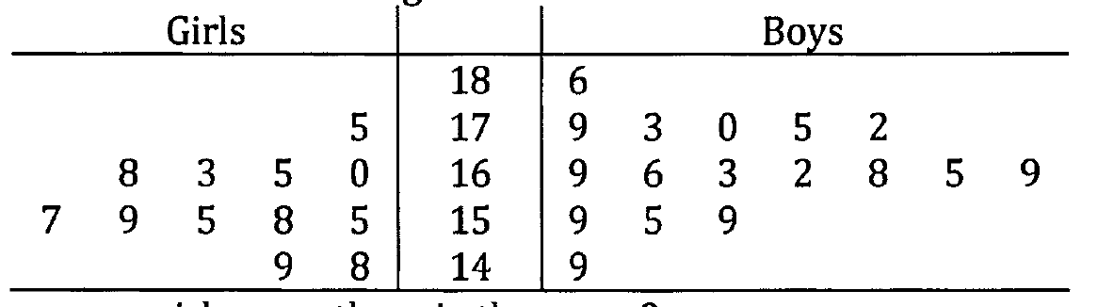
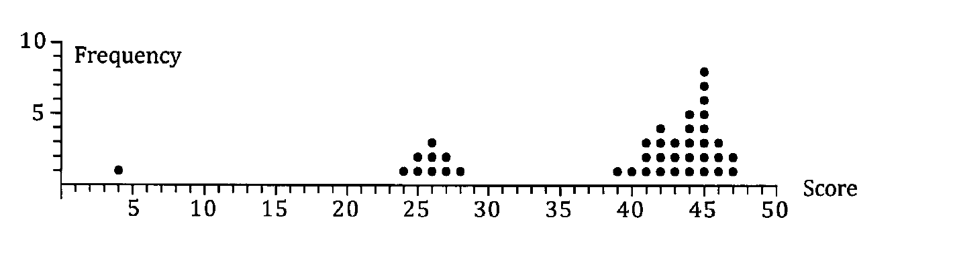
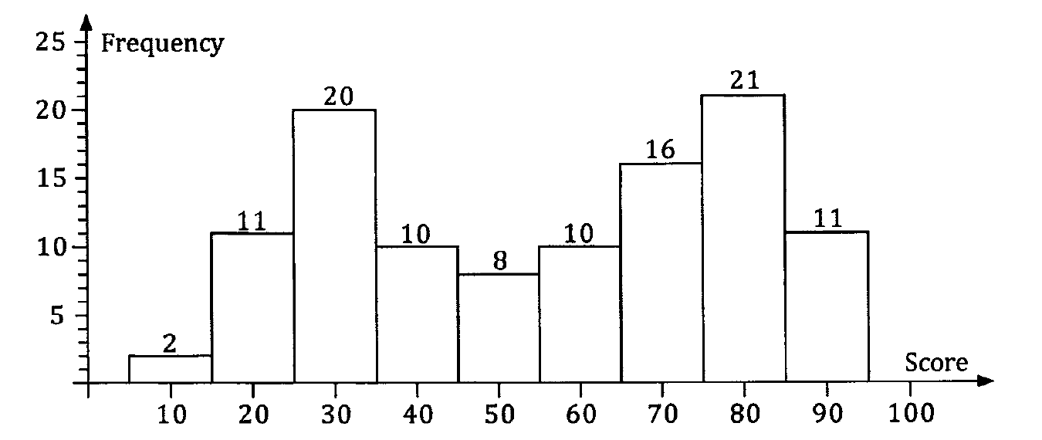
Different ways of representing data
Stem and leaf diagram
Dot frequency diagram
Histogram

Slide 3
Box plot
Also known as box and whisker diagram
From the data collected, it is necessary to work out:
Minimum
Maximum
Median (50th percentile, second quartile)
Lower quartile (25th percentile, first quartile)
Upper quartile (75th percentile, third quartile)
Inter quartile range (IQR) = upper quartile – lower qurtile

Slide 4
Notes:
http://intermath.coe.uga.edu/dictnary/descript.asp?termID=57

Slide 5
Notes:
http://www.mathcaptain.com/statistics/analyzing-data.html

Slide 6
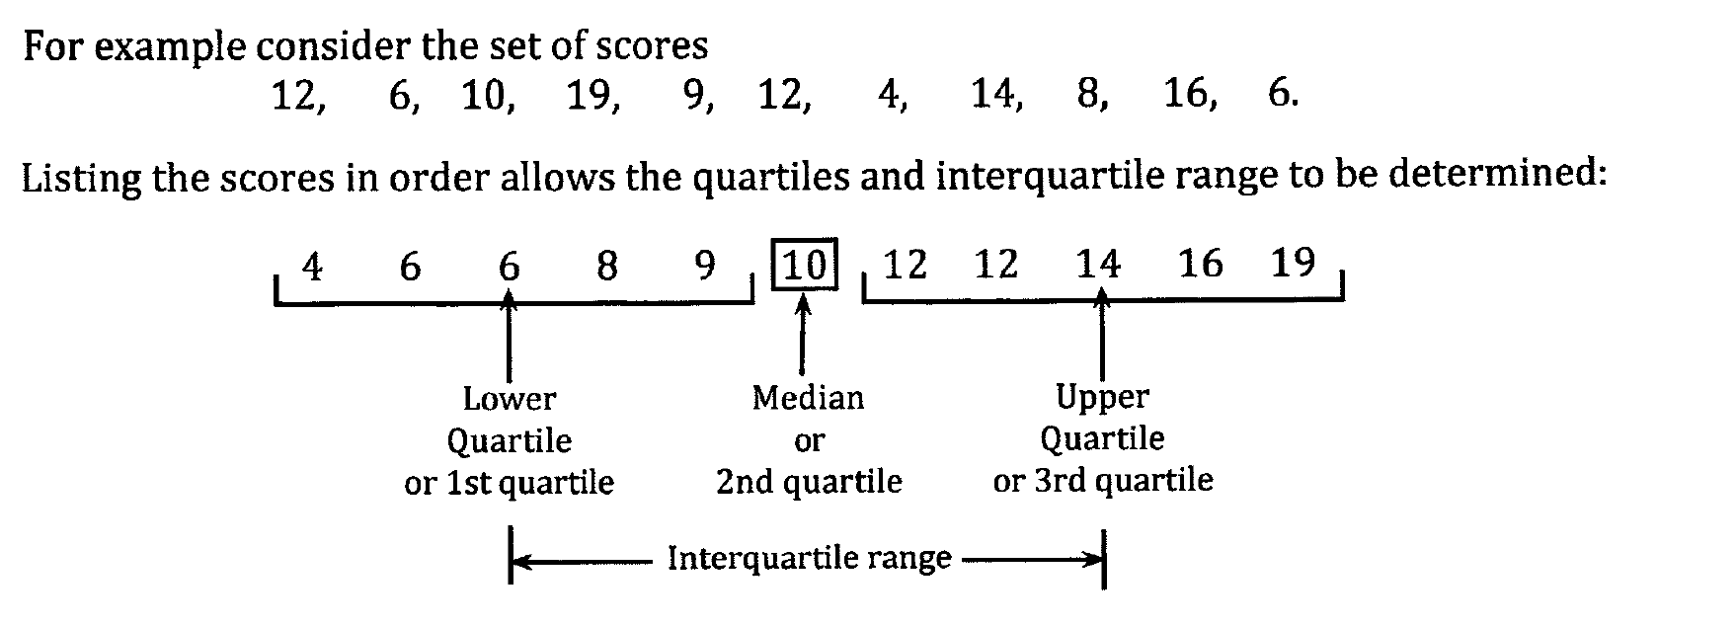
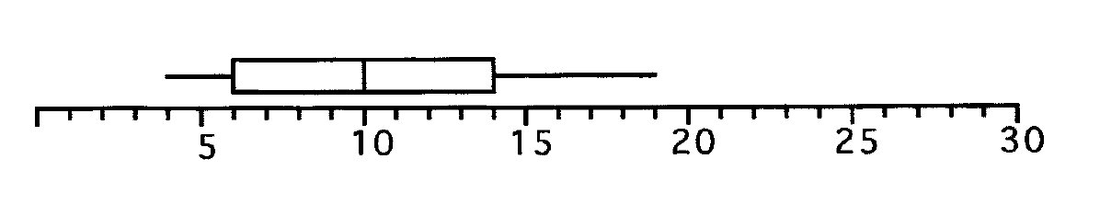
Example

Slide 7
Draw the box plot for the following data
This is the consumer rating for a particular brand of peanut butter:
71 69 60 60 57
52 34 89 69 69
67 63 57 40
Notes:
http://intermath.coe.uga.edu/dictnary/html/MakingPlots.html#box&whisker

Slide 8
Step 1: Arrange the data from smallest to largest and label them from 1 to the number of data points:
Step 2: Find the median of the data:
We have 14 data values, so to compute the median of an even number of data values we compute the mean of the two middle values: 7 and 8 (14/2 = 7, 14/2 + 1 = 8) . So with the data above we get : (60+63)/2 = 61.5
Notes:
http://intermath.coe.uga.edu/dictnary/html/MakingPlots.html#box&whisker

Slide 9
Step 3: Find the lower quartile:
The lower quartile is the median of the numbers above. Since we have an odd number of data points the median is the data value with rank (7+1)/2 = 4. So the lower quartile is 57.
Step 4: Find the upper quartile:
The upper quartile is the median of the numbers above. Since we have an odd number of data points the median is the data value with rank (7+1)/2 = 4. So the upper quartile is 69.
Notes:
http://intermath.coe.uga.edu/dictnary/html/MakingPlots.html#box&whisker

Slide 10
Step 4: Find the minimum and maximum value:
Step 5: Create the Box-and-Whisker Plot:
The rectangle is drawn from the lower quartile (57) to the upper quartile (69) the vertical line in the middle is the median (61.5). The whiskers extend to the minimum value (40) and the maximum value (89).
Notes:
http://intermath.coe.uga.edu/dictnary/html/MakingPlots.html#box&whisker

Slide 11
OUTLIERS
Notes:
https://www.leansigmacorporation.com/box-plot-with-minitab/

Slide 12
Example
Draw a box plot for the following data:
55 48 42 75 40 49 53 50 52
50 5 46 58 56 102

Slide 13
Lower quartile
Median
Upper quartile
Inter quartile range (IQR) = 56 – 46 = 10
Maximum = 56 + 1.5 x IQR = 56 + 1.5 x 10 = 56 + 15 = 71
Minimum = 46 – 1.5 x IQR = 46 – 15 = 31
Notes:
https://www.varsitytutors.com/hotmath/hotmath_help/topics/box-and-whisker-plots

Slide 14
x
x
x

